Slide 1
TWEESENT Sentiment Analysis of COVID-19 Tweets – Visualization Dashboard (DATA COLLECTION)
By:
Name Terror
(Roshan Dadlani)

Slide 2
DATA COLLECTION
Twitter is a gold mine of data. Unlike other social platforms, almost every user’s tweets are completely public and pullable. This is a huge plus if you’re trying to get a large amount of data to run analytics on. Twitter data is also pretty specific. Twitter’s API allows you to do complex queries like pulling every tweet about a certain topic within the last twenty minutes, or pull a certain user’s non-retweeted tweets.
Data collection is a major bottleneck in machine learning and an active research topic in multiple communities. There are largely two reasons data collection has recently become a critical issue. First, as machine learning is becoming more widely-used, we are seeing new applications that do not necessarily have enough labelled data. Second, unlike traditional machine learning, deep learning techniques automatically generate features, which saves feature engineering costs, but in return may require larger amounts of labelled data.

Slide 3
DATA COLLECTION
Interestingly, recent research in data collection comes not only from the machine learning, natural language, and computer vision communities, but also from the data management community due to the importance of handling large amounts of data. In this survey, we perform a comprehensive study of data collection from a data management point of view. Data collection largely consists of data acquisition, data labelling, and improvement of existing data or models. We provide a research landscape of these operations, provide guidelines on which technique to use when, and identify interesting research challenges. The integration of machine learning and data management for data collection is part of a larger trend of Big data and Artificial Intelligence (AI) integration and opens many opportunities for new research.

Slide 4
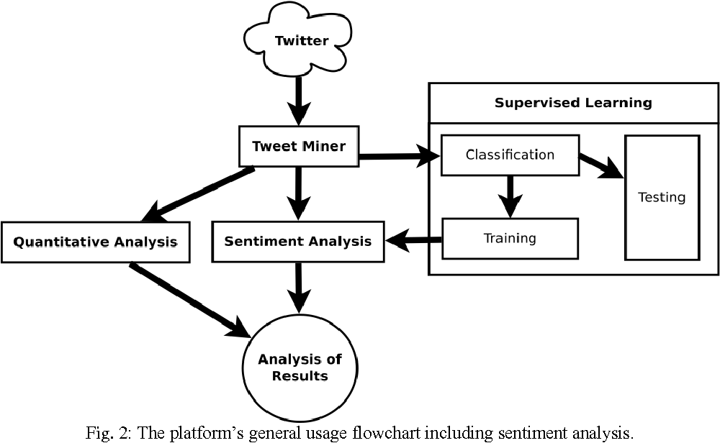
FLOW CHART FOR DATA COLLECTION

